Slide 1
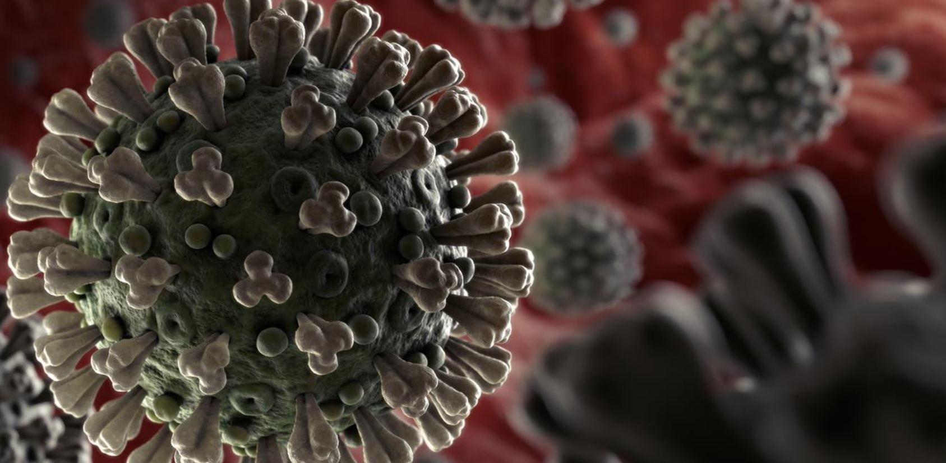
Epidemiology of The Novel Coronavirus responsible for COVID-19*
AKA SARS-CoV-2^{ð}
Dr. Avery Q .J. Hinds
Technical Director
Epidemiology Division
Ministry of Health
* World Health Organisation (WHO); ^{ð} Coronavirus Study Group (CSG) of the International Committee on Taxonomy of Viruses

Slide 2
Current Figures(Sit-Rep 44: 04 March, 2020)
Total Cases
  90,090
Spectrum of illness (Study: n= 44,415)
  Mild - 81%
  Severe – 14%
  Critical – 5%
Deaths
  3198
Countries affected outside China
76 countries with imported cases (4 new since Sit-Rep 43 )
  Argentine, Chile, Poland & Ukraine have reported cases of COVID-19 in the past 24 hours.
Case Fatality Rate
~3.54%

Slide 3
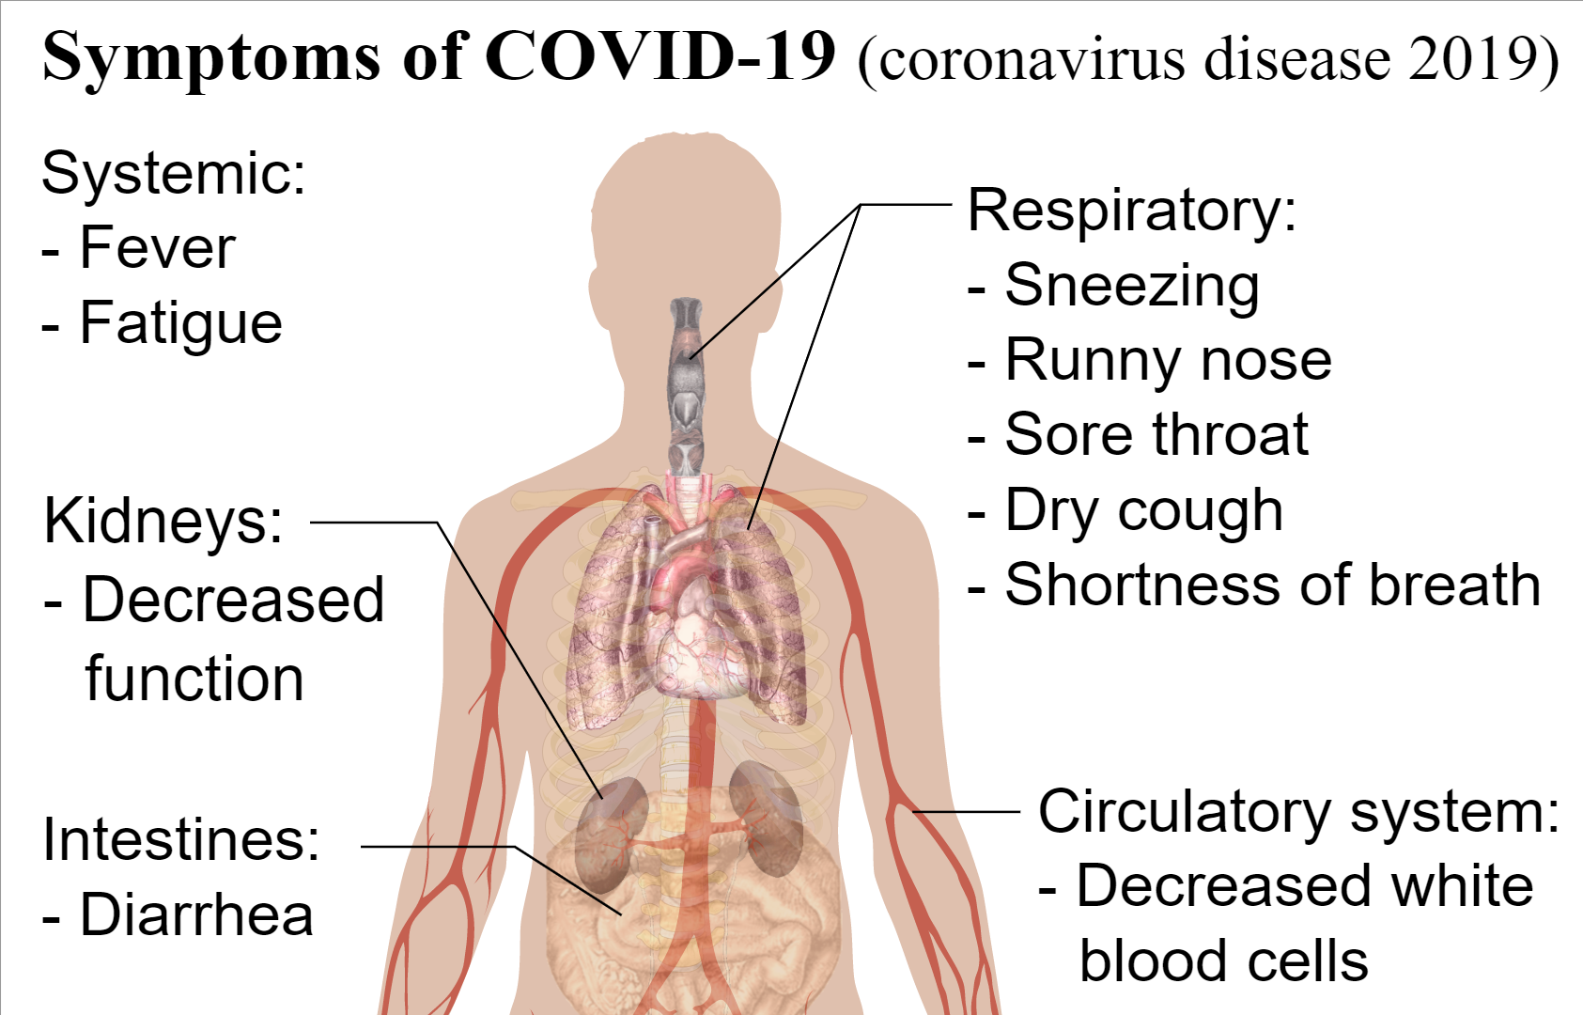
General Presentation of COVID-19

Slide 4
Case Definitions: Suspected Case
Suspect case:
Patient with severe acute respiratory infection (fever, cough, and requiring admission to hospital),
AND with no other etiology that fully explains the clinical presentation
AND a history of travel to or residence in Countries with COVID-19 cases during the 14 days prior to symptom onset
OR
Patient with any acute respiratory illness AND at least one of the following during the 14 days prior to symptom onset:
a) contact with a confirmed or probable case of 2019-nCoV infection, or
b) worked in or attended a health care facility where patients with confirmed or probable 2019-nCoV acute respiratory disease patients were being treated

Slide 5
Case Definitions: Probable & Confirmed Cases
Probable case:
A suspect case for whom testing for 2019-nCoV is inconclusive or is tested positive using a pan-coronavirus assay and without laboratory evidence of other respiratory pathogens.
Confirmed case:
A person with laboratory confirmation of 2019-nCoV infection, irrespective of clinical signs and symptoms.

Slide 6
How is it spread?

Slide 7
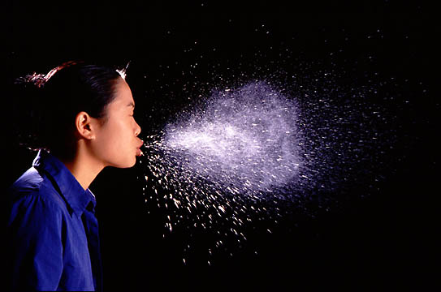
Droplet Transmission

Slide 8
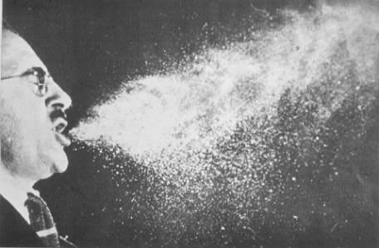
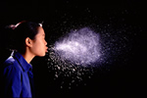
Fate of Droplets
Organisms Liberated
Talking 0-200
Coughing 0-3500
Sneezing 4500-1,000,000
Droplets travel ~1-2m before landing on surfaces.

Slide 9
Droplet transmission
Droplet generation
  coughing,
  sneezing,
  talking,
  procedures such as suctioning and bronchoscopy
Droplet transmission
Droplet deposited on the host’s conjunctivae, nasal mucosa, or mouth.
Notes:
Droplets – generated from the source person primarily during coughing, sneezing, and talking, and during the performance of certain procedures such as suctioning and bronchoscopy
Droplet transmission occurs when droplets containing microorganisms generated from the infected person are propelled a short distance through the air and deposited on the host’s conjunctivae, nasal mucosa, or mouth.

Slide 10
Preventive Mechanisms
Personal
Hand Hygiene
Respiratory Ettiquette
Social Distancing
National
Quarantine
Isolation
Infection Prevention and Control procedures and equipment

Slide 11
Hierarchy of Preventive Approaches
Mechanisms Supporting Monitoring
Mechanisms Supporting Prevention
Institutional
Quarantine
Home-based quarantine & isolation
Population Hygiene Precautions
Social Distancing Practices
Institutional isolation
Severe acute Respiratory Illness (SARI) Surveillance
IPC protocols for formal isolation
Protocols for formal quarantine accompanied by daily monitoring by PH officials and laboratory confirmation
Institutional Event-Based Surveillance/Reporting
Formal protocols for home-based quarantine and isolation accompanied by daily monitoring by PH officials
Community Event-Based Surveillance/Reporting
THP Syndromic surveillance
Labour policies and practices supporting sick leave and remote work
Syndromic Fever and Respiratory Surveillance
Health Promotion Materials via media channels

Slide 12
Stages of Preparation
Prevention
Preparedness
Containment
Mitigation

Slide 13

Questions/Comments

